Slide 1
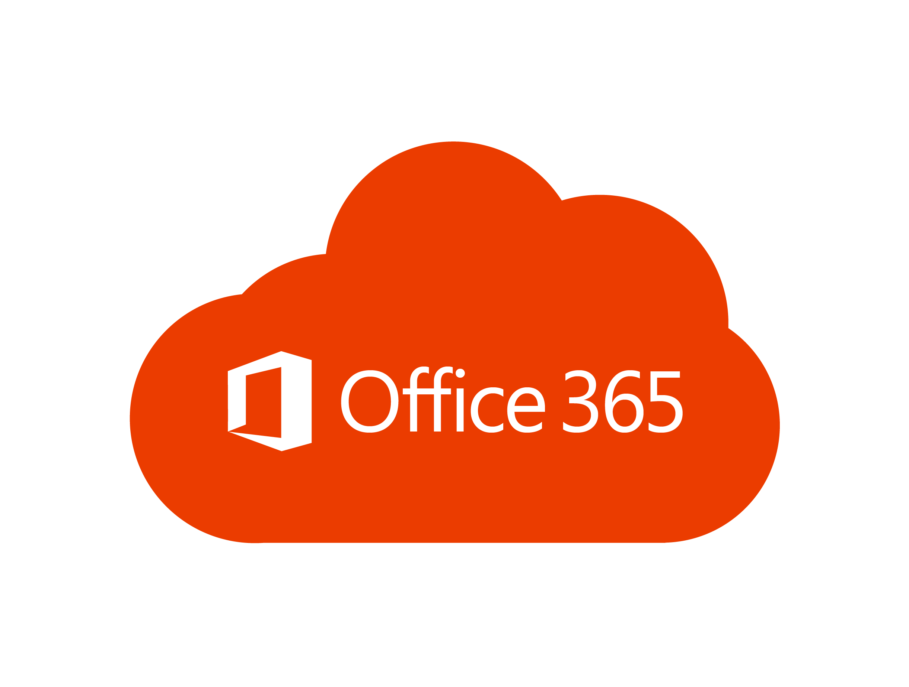
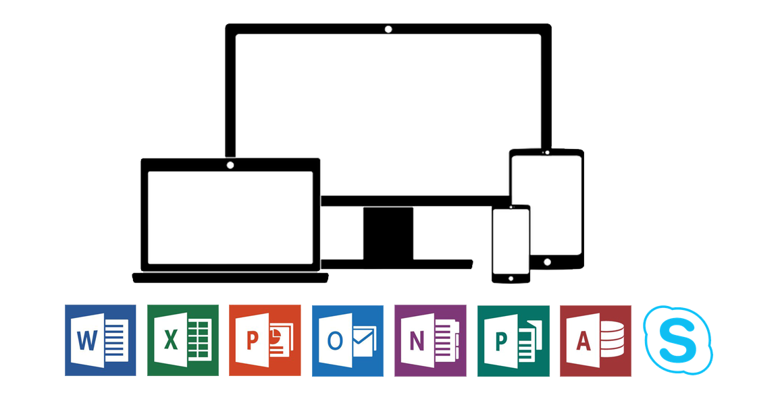
Log in to Office 365 on a laptop

Slide 2


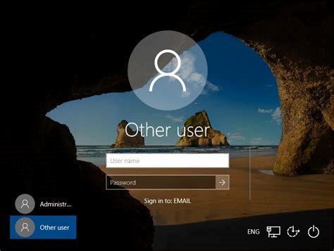
1. Type your student number
Example: 234567
2. Type your password
3. Click the arrow

Slide 3
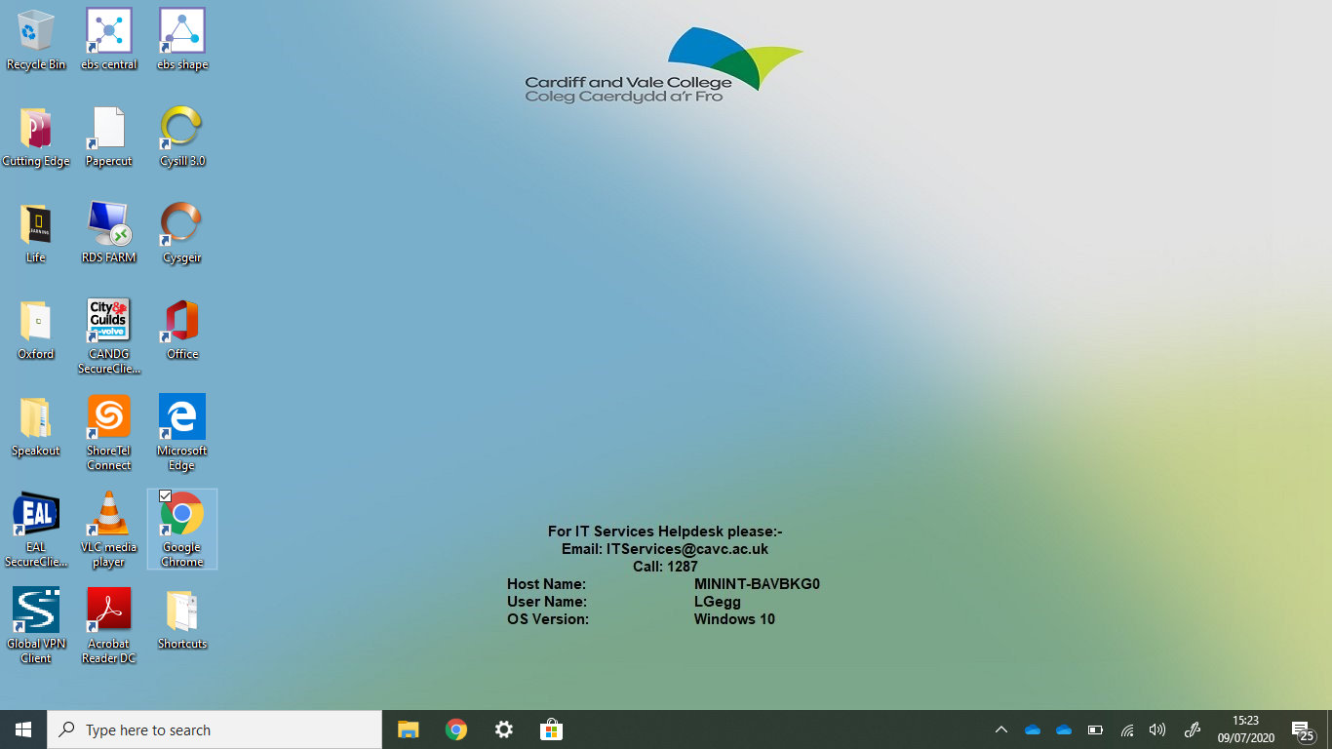


This is the desktop
4. Open an internet browser
5. Click here or here

Slide 4
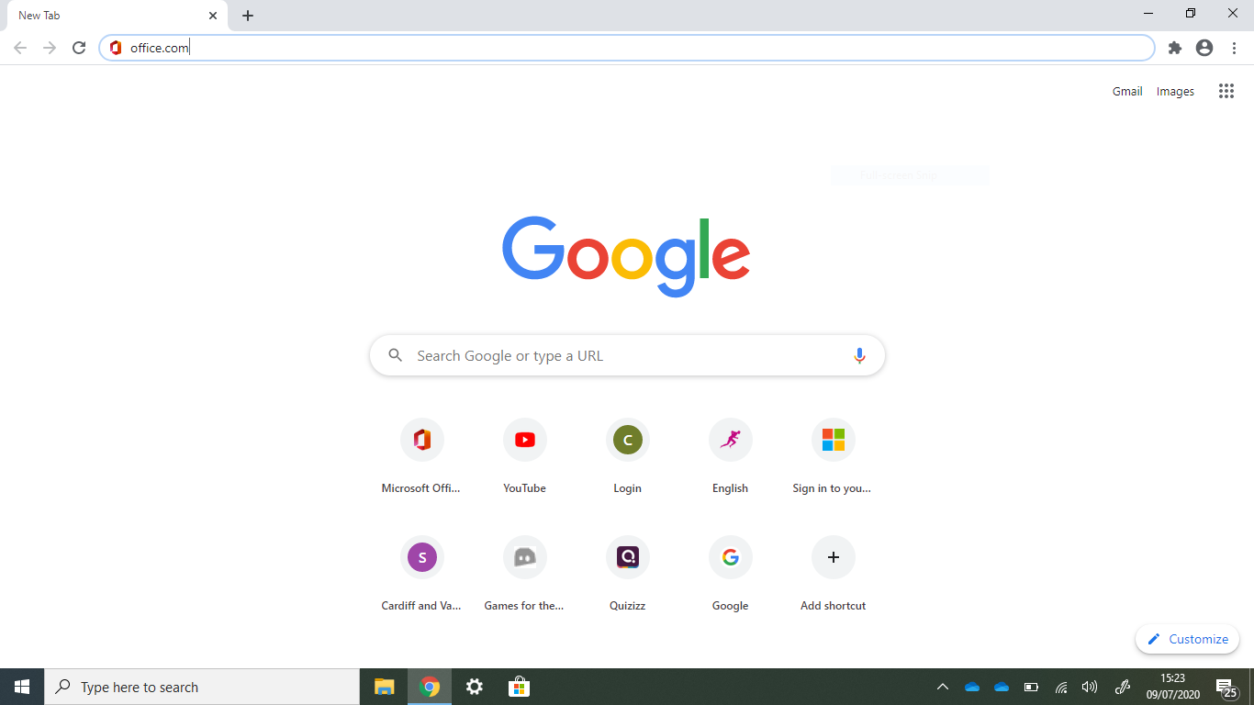
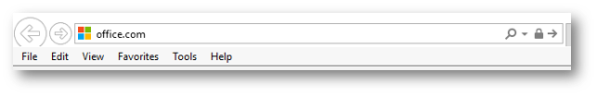
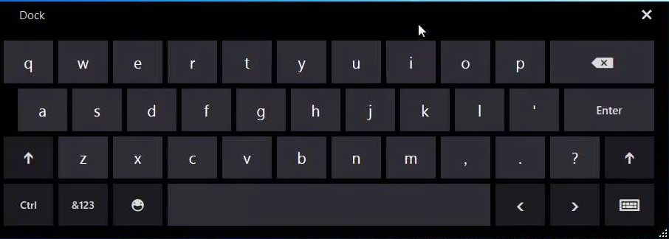
6. Type Office.com in the address bar

Slide 5
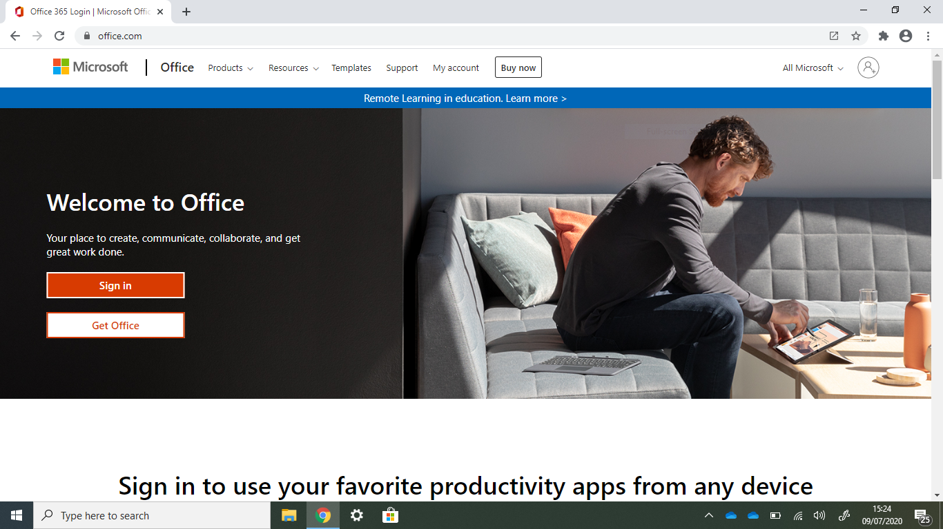
7. Click Sign in

Slide 6
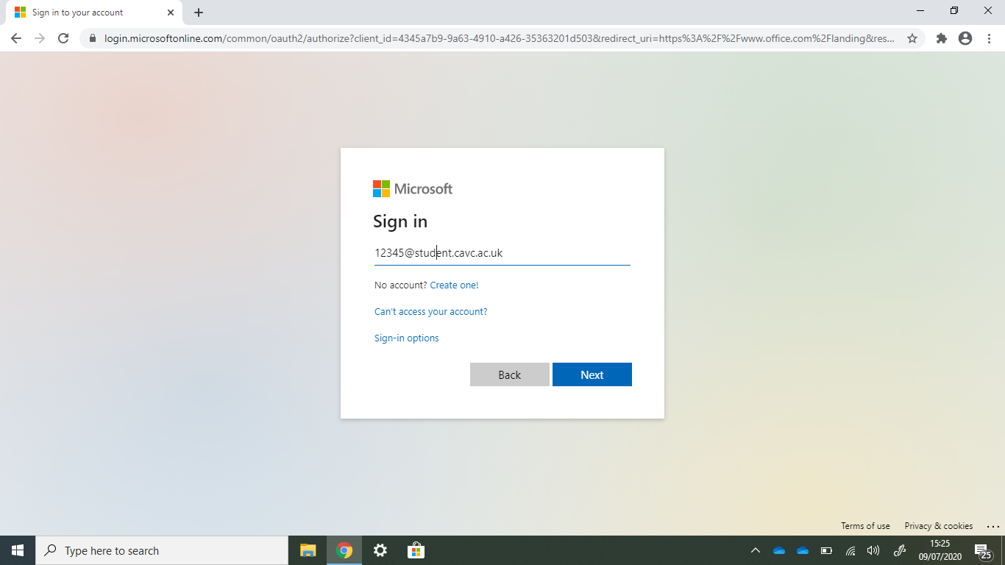
8. Type your
student email address
Example: 234567@student.cavc.ac.uk
9. Click Next

Slide 7
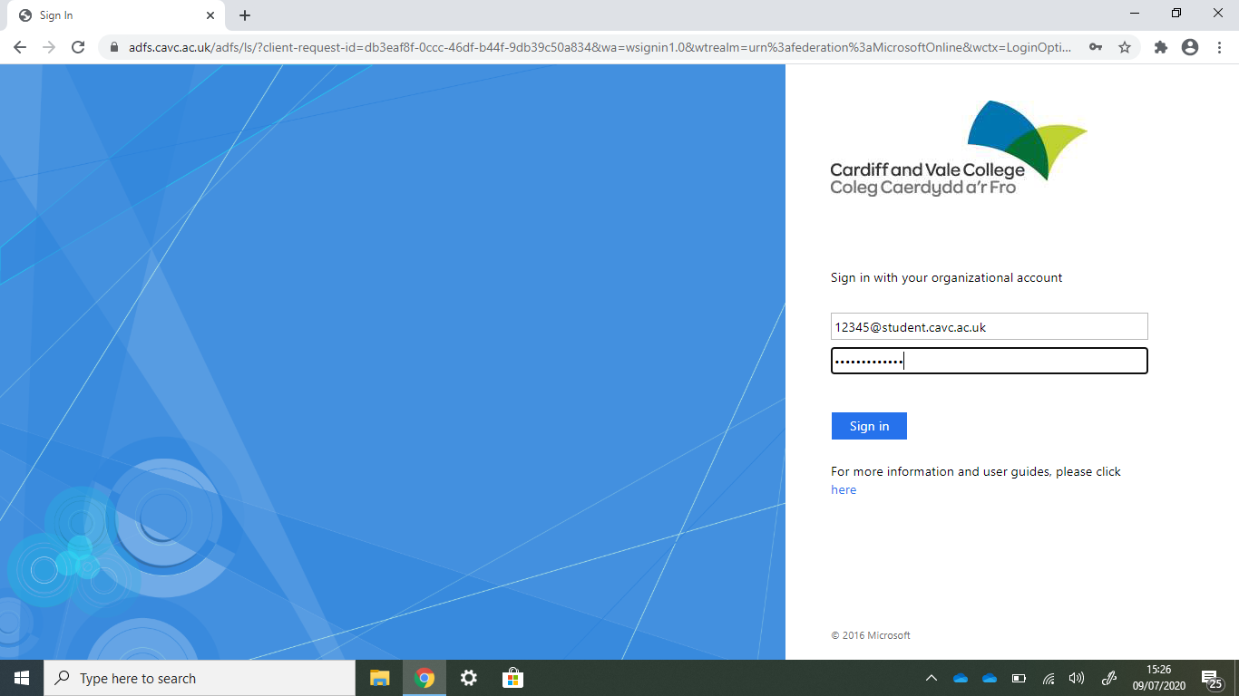
10. Type your password
11. Click Sign in

Slide 8
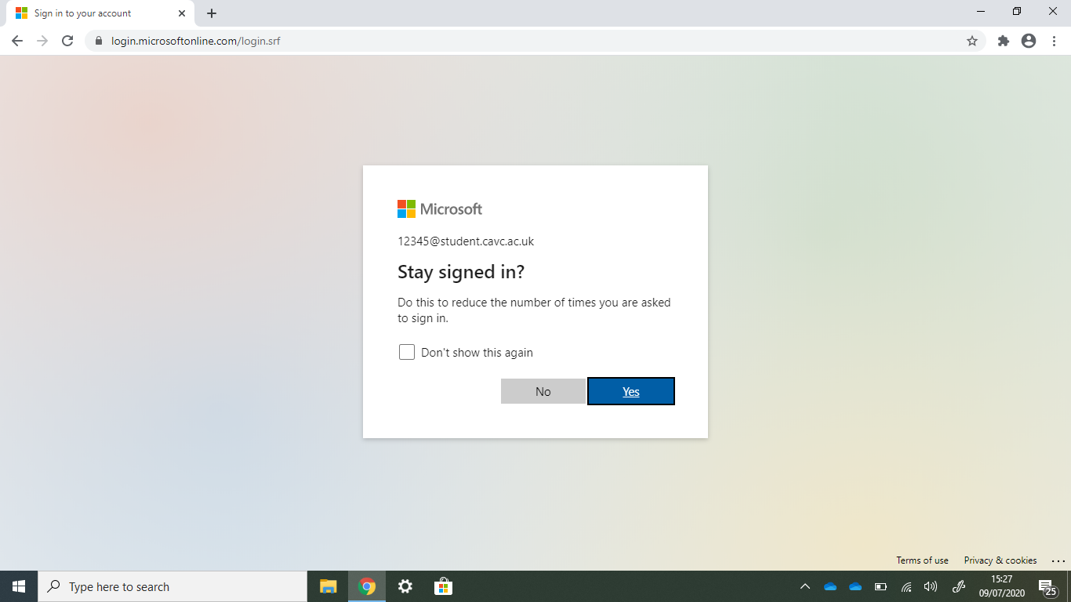
12. To stay
signed in
Click
Yes

Slide 9
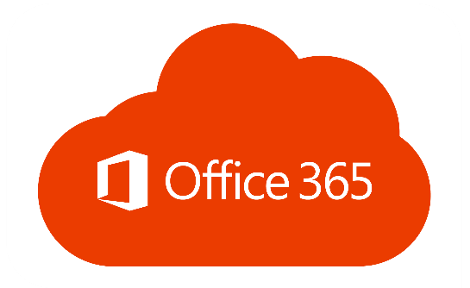
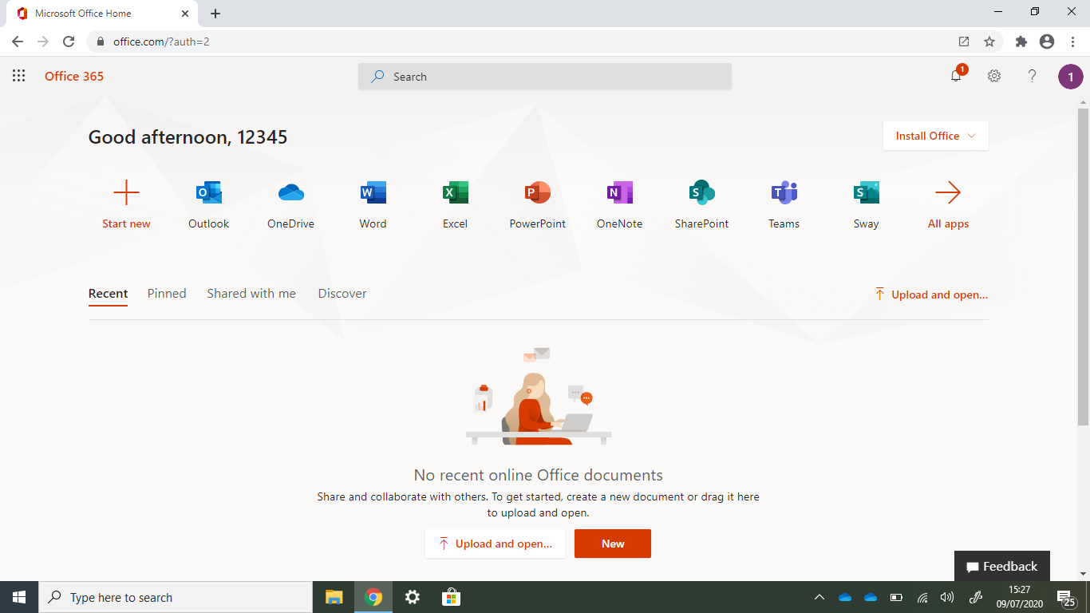


This is the homepage
11. Outlook is your student email
12. Teams is your class work area

